Slide 1
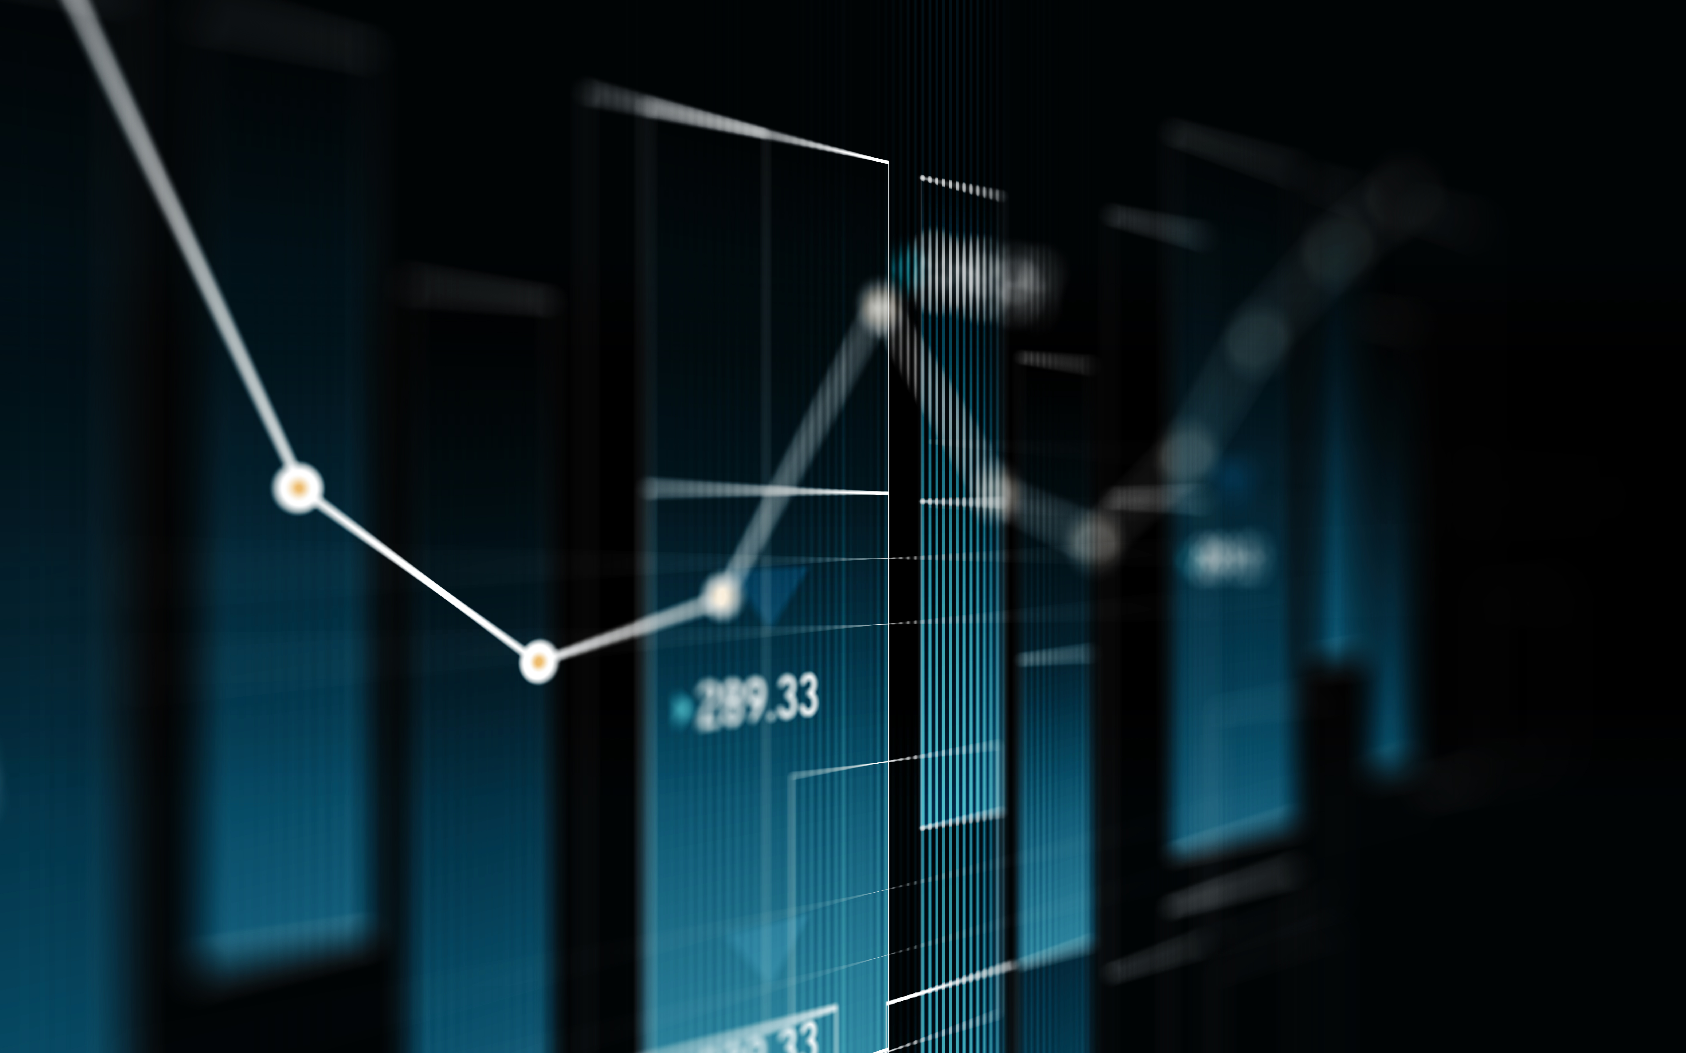
Stock predictor
By Mohd Abedin

Slide 2
Introduction
Everyone may probably have the question that why a stock predictor when there are ton of apps out there doing the same thing?, What makes your thing unique than others. Well the answer is simply; we just tried a better version by exploring deep into machine learning . If you ask us why the application stock predictor? We also have an answer for that. Now if we look closely, the world kinds of runs on stock market these days and it will so on continue in future as well. Now being an investor its very imperial to know on which company you want to invest in, and we can't blindly invest on a company without knowing the proper prices of shares that are present in market. to trade. It is impossible to predict the future but however applications can be made for investors that can possibly predict the stock prices and give a possible insight to the investor. The application would use low price and time lags to predict future highs while another network would use lagged highs to predict future highs.

Slide 3
Problem statement and objective :
One of the key problems with the current theme is that; the accuracy for predicting the stock prices is one major concern because right now outside in the market there are many predicter software but lack in accuracy. One key reason for the why this occurs is because the stock market is never in a stable state. And second, those software present their prices using the quarterly financial ratio using the dataset. Thus, relying on a single dataset may not be enough for the prediction and can give a result which is inaccurate. The movement in the stock market is usually determined by the event that happen around the companies and governments globally and with the choices and decisions made by the investors. Hence, we are contemplating towards the study of machine learning with various datasets integration to predict the market and the stock trends. we believe that once the right data is collected, it then can be used to train a machine and to generate a predictive result.

Slide 4
Domain
In general, a stock represents an ownership claim on business by an individual or a group of people. The attempt to determine the future value of the stock market is known as a stock market prediction. The prediction is expected to be far efficient and accurate.

Slide 5
Hardware and software requirements
Operating System: Windows 7 & above
Ram: 1GB or above
Language: Python (version 3.8.2)
Processor: Intel i3 & above
Space Requirement: 500MB or above
Graphics: Intel Graphics or Nvidia

Slide 6
Additional dependencies that were used:
Pandas – Version 1.0.3
NumPy – Version 1.18.4
Pandas-Datareader – Version 1.0.0
pyQt5 – Version 5.3.1 { UI DESIGN }
scikit_learn – Version 0.22.2
requests – Version 2.23.0
matplotlib.pyplot – Version 3.2.1

Slide 7
Background study
So before we dwelled into the project, we did some study and found some techniques like support vector machine weren’t completely explored or used, so we decided to present an application that yield comparatively accurate results and try out in a feasible method. First thing we have considered is the dataset of the stock market prices from previous year. The dataset was pre-processed and tuned up for real analysis. It focuses mainly on data preprocessing of the raw dataset.
Secondly, after preprocessing the data, we had reviewed the use of support vector machine on the dataset and the outcomes it generates. This project presents a machine learning model to predict the longevity of stock in a competitive market..

Slide 8
Literature review
Stock market prediction has become a very significant issue over the period. Yielding accurate results is very challenging . Generally, investments are made using predictions that are obtained from the stock price after considering all the factors that might affect it. The technique that was employed in this instance was a regression. Since financial stock marks generate enormous amounts of data at any given time a great volume of data needs to undergo analysis before a prediction can be made. Each method in regression has its on pro’s and cons but one technique that is useful is Linear Regression.
The way linear regression works is that they are often fitted using the least squares approach, but they may alternatively be also be fitted in other ways, such as by diminishing the "lack of fit" in some other norm, or by diminishing a handicapped version of the least squares loss function. Conversely, the least squares approach can be utilized to fit nonlinear models.

Slide 9
Design and analysis
The design has been created from scratch keeping in mind the simplicity and elegance of the application.
The design has been constructed in a such a way that the user’ s have the access to view graphs and interact fluently with the application.
It consists of very simple components, starting from a Login Panel where the users are required to input their credentials.
Secondly, the application consists of a Signup Panel where the new users can register and then continue enjoying the application.
Third comes the Main User Portal, where after successfully logging in, the user is can access the required company closed prices as results in the portal with its charts.

Slide 10
Implementation details
Implementation process is very simple and unique as it is hardwired into simple lines of code for processing which takes less processing power of the CPU and gives quick responses.
Firstly, the program waits for the user to input a company’s ticker name ( initials ) and then enter the day the user wants the closed prices on.
As per the first input by the user, the application will collect a good amount of raw data from Yahoo finance database and create a csv file of its own to store it.
The models RBF, Linear, Polynomial & Linear Regression takes this file as input data and trains them according to the data.
The processing may take a while as retraining the models will put a small amount of load on the CPU.
After which, the application displays a chart consisting the closed prices of one year of the user entered company and it points the models results too.

Slide 11
Results:
Based on the user input data and the collection of the raw data from Yahoo Finance, the models prepare themselves to train it according to the algorithms.
The models are based on Machine Learning and train themselves based on the raw data provided which in this case is the collected data.
A chart will be shown plotted with the collected data and the expected results calculated by the four models marked with different colors.
Upon closing the chart window, the user can clearly see the results generated by each model in integers and then the user may decide which values are close enough to their strategies when investing in a certain company.

Slide 12
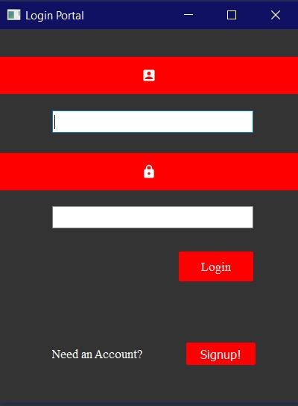
The login portal

Slide 13
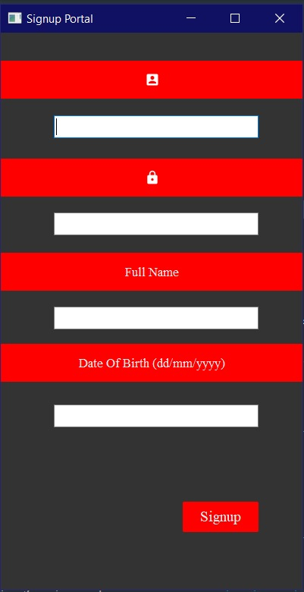
Signup section

Slide 14
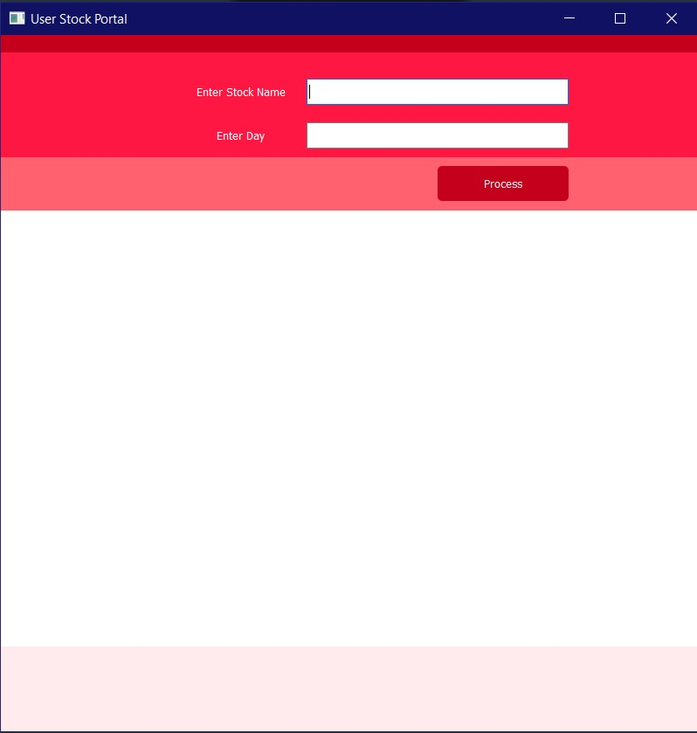
Main screen of the app

Slide 15
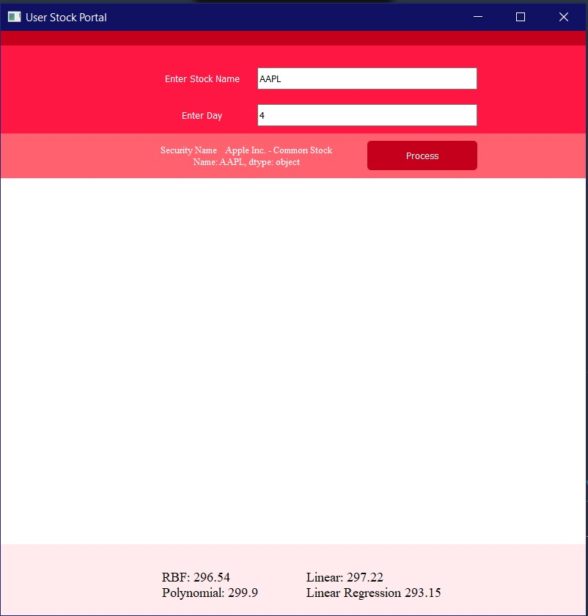
Entering the values

Slide 16
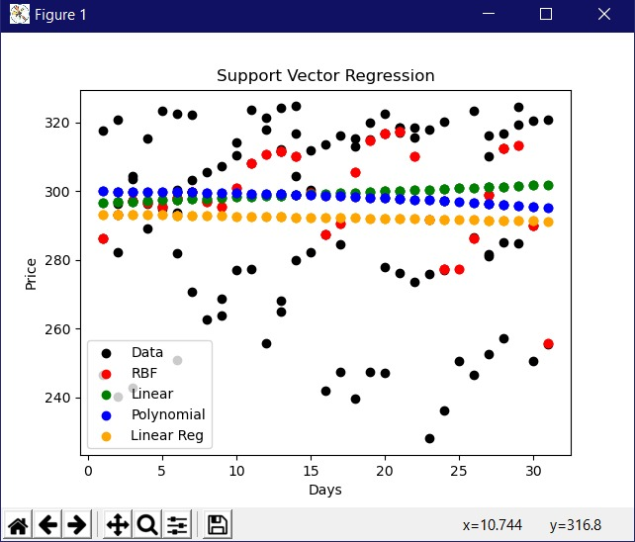
The graph the application generates

